Slide 1
PHYS4260 Quantum Mechanics II Spring 2025
Symmetries and Conservation laws

Slide 2
Preamble
Your journey into QM started in the Modern Physics class when you learned new concepts in physics .
In Quantum Mechanics I, you reviewed the same material studied in Modern Physics, with a more refined formalism (Dirac’s notation, Hilbert spaces and operators) for the wave function and Schrödinger Equation (Hydrogen atom, etc.).
In PHYS4260 you will continue this fascinating journey. We’ll focus on the concept of symmetry (ubiquitous throughout this course) and its role in the conservation laws of Nature.
We will analyze aspects of quantum dynamics through application studies of perturbation and scattering theory.
We will arrive at the necessity of a field viewpoint (more if time permits).

Slide 3
Outline
Intro and transformations in space
Translation operator
Conservation Laws

Slide 4
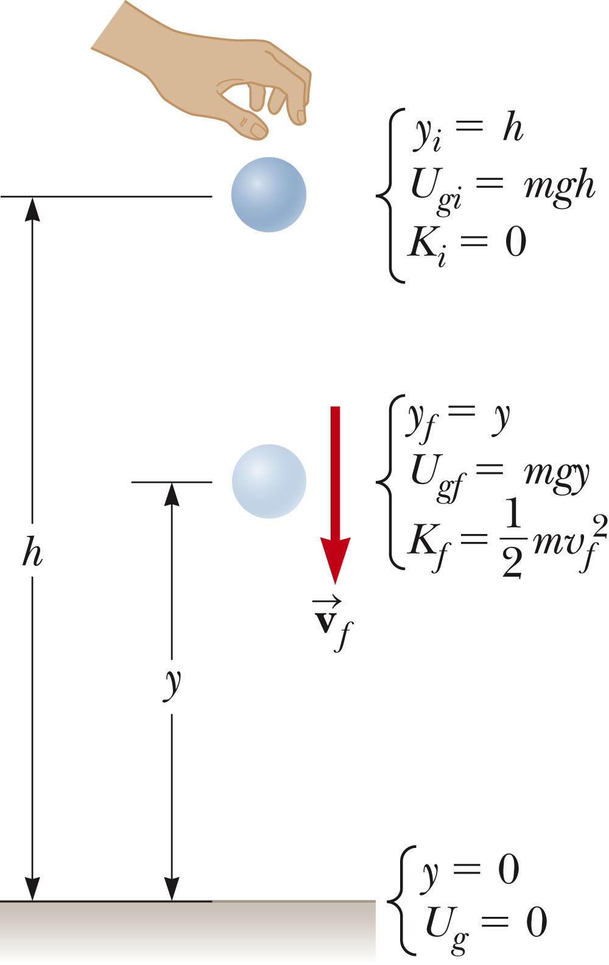
Intro
Conservation laws (energy, momentum, and angular momentum) are familiar from your first course in classical mechanics.
Energy Conservation
Consider a system in which conservative forces act.
The changes in energy can be written out and rearranged: K_{f} + U_{f} = K_{i} + U_{i}
System: ball + Earth
System is isolated
The only force is gravitational: conservative
Conservation of Mechanical Energy
K_{f} + U_{gf} = K_{i} + U_{gi}
K_{i} = 0, the ball is dropped
Solve for v_{f}

Slide 5
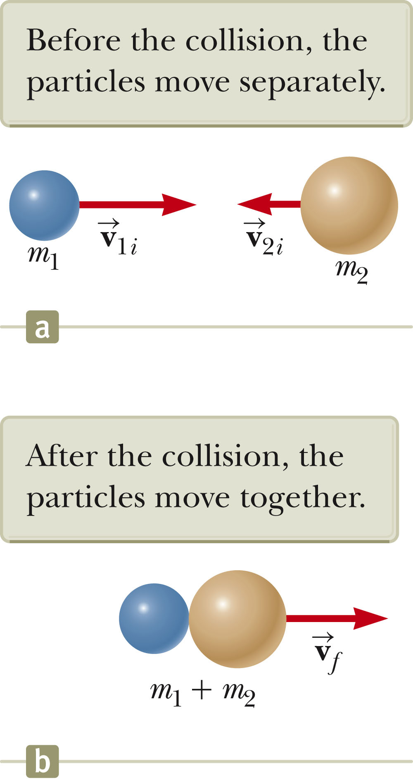
Momentum Conservation
Let’s consider a perfectly inelastic collision.
The momentum of an isolated system is conserved in any collision. Therefore, the total momentum before the collision is equal to the total momentum of the composite system after the collision.
Since the objects stick together, they share the same velocity after the collision.

Slide 6
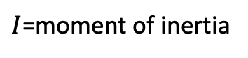
Angular Momentum Conservation
;
for rigid objects
Formation of a neutron Star. A star rotates with a period of 30 days about an axis through its center. The period is the time interval required for a point on the star’s equator to make one complete revolution around the axis of rotation.
After the star undergoes a supernova explosion, the stellar core, which had a radius of 10⁴ km, collapses into a neutron star of radius 10.0 km. Determine the period of rotation of the neutron star.
$I$=moment of inertia
The system is isolated for angular momentum

Slide 7
These same conservation laws hold in quantum mechanics.
In both contexts they are the result of symmetries.
Question 1: what is a symmetry ?
Question 2: what does it mean for something to be conserved in quantum mechanics ?
Question 3: what is the relation between (Symmetry and Conservation)?
We’ll investigate two related properties of quantum systems—energy level degeneracy and
the selection rules that distinguish allowed from “forbidden” transitions.

Slide 8
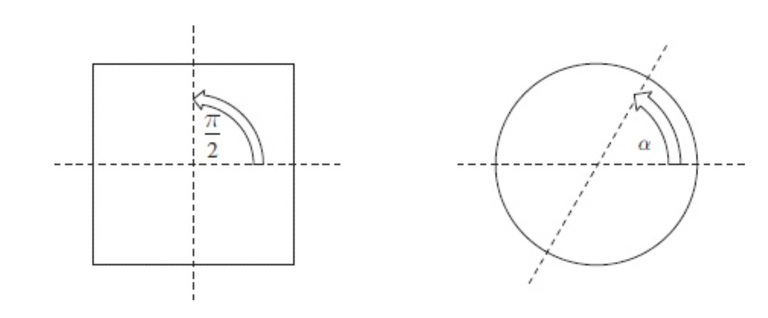
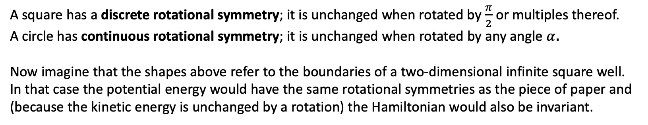
What is a Symmetry?
It is some transformation that leaves a system unchanged.
A square has a discrete rotational symmetry; it is unchanged when rotated by $\frac{π}{2}$ or multiples thereof.
A circle has continuous rotational symmetry; it is unchanged when rotated by any angle $α$.
Now imagine that the shapes above refer to the boundaries of a two-dimensional infinite square well.
In that case the potential energy would have the same rotational symmetries as the piece of paper and
(because the kinetic energy is unchanged by a rotation) the Hamiltonian would also be invariant.

Slide 9
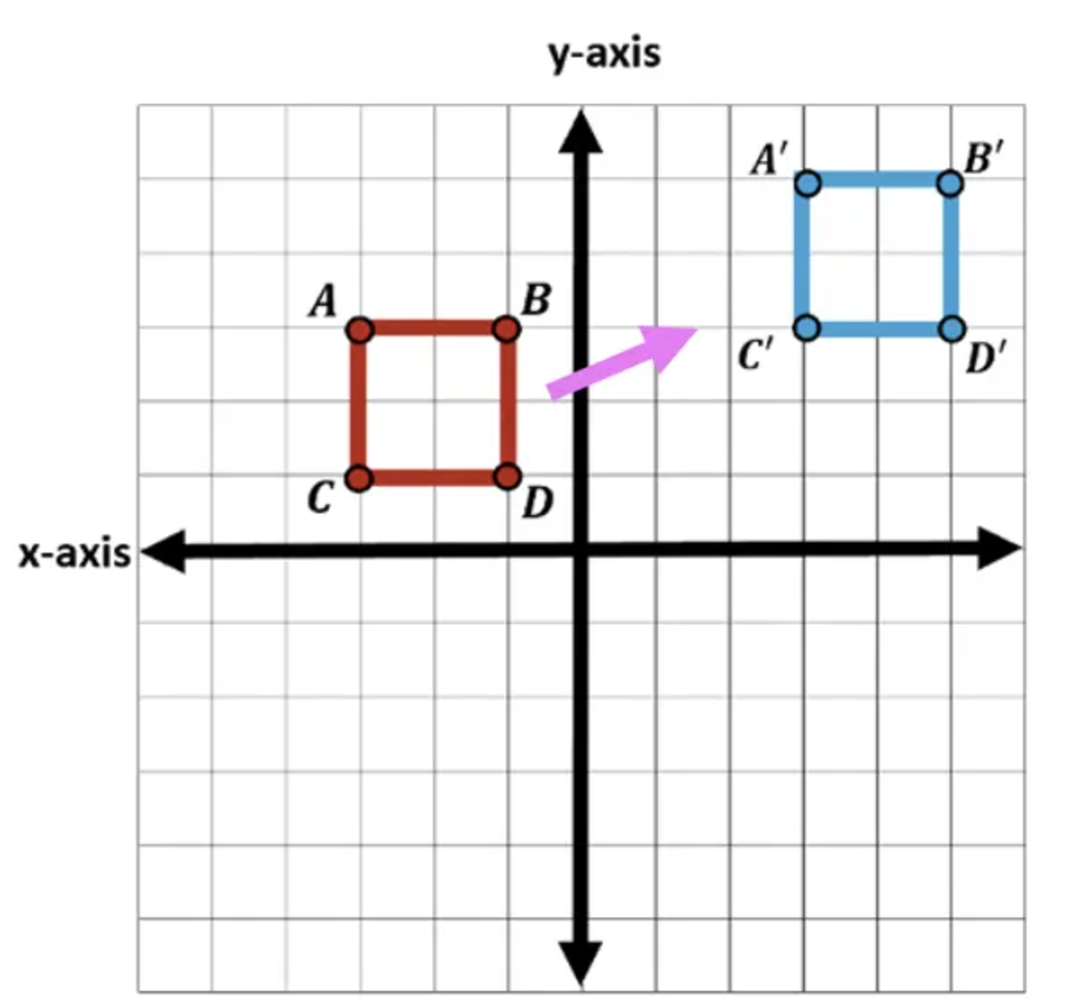
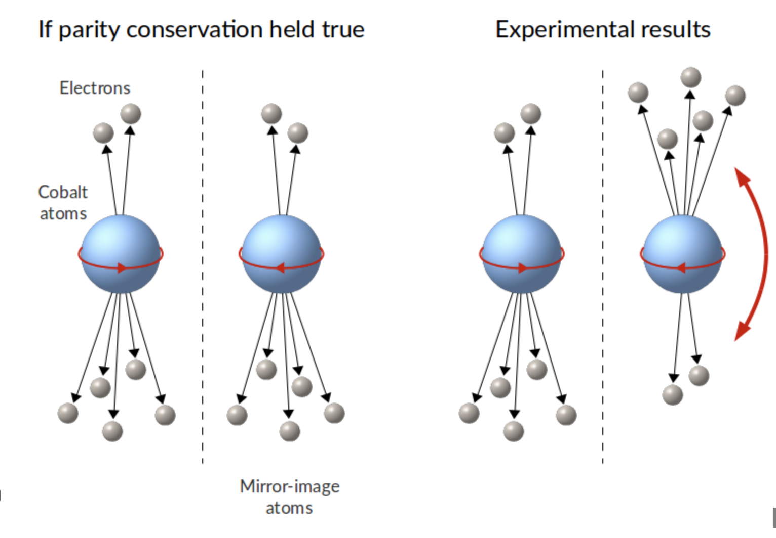
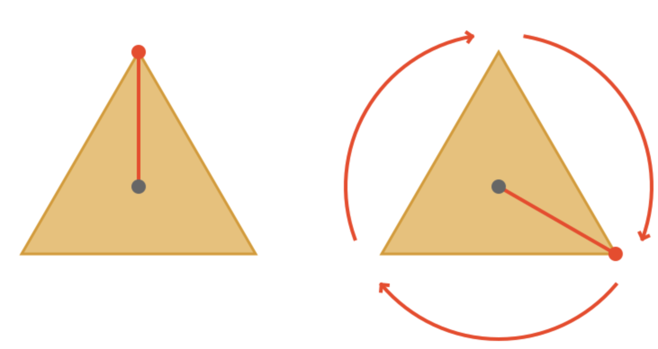
Transformations in space
Translations
Inversions
Rotations

Slide 10
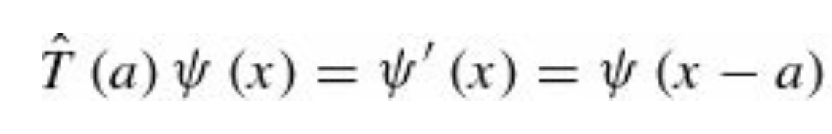
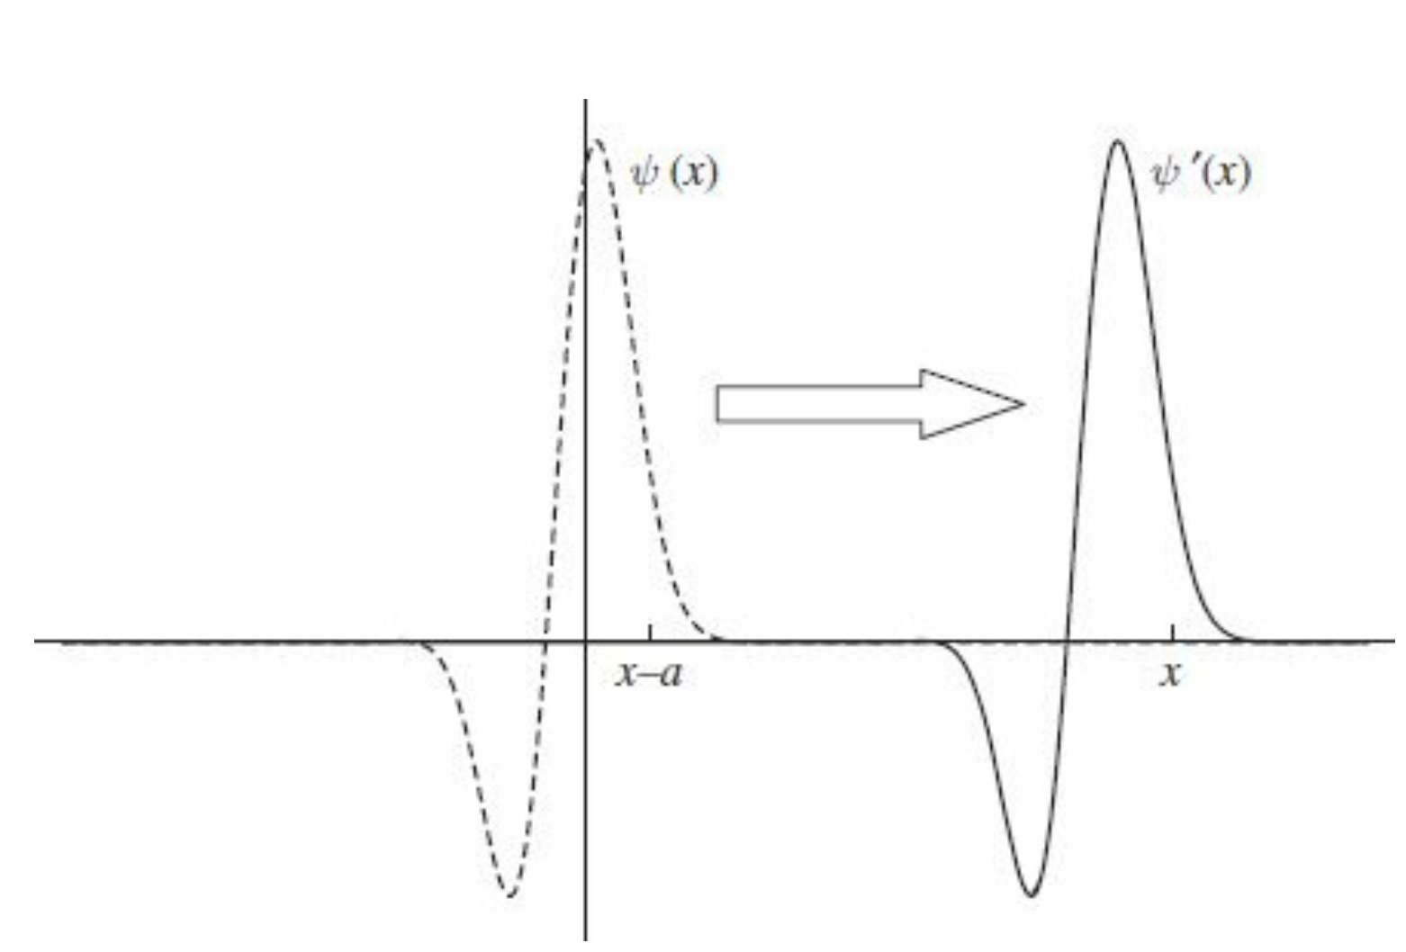
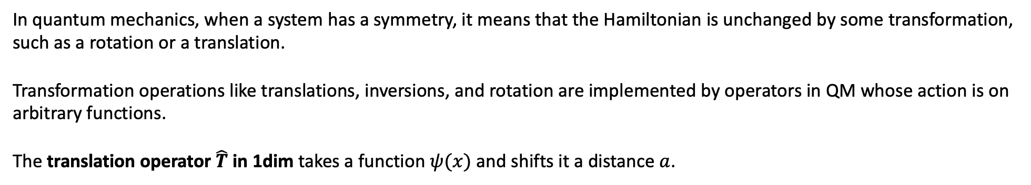
Transformations in space: Translations
In quantum mechanics, when a system has a symmetry, it means that the Hamiltonian is unchanged by some transformation,
such as a rotation or a translation.
Transformation operations like translations, inversions, and rotation are implemented by operators in QM whose action is on
arbitrary functions.
The translation operator $\hat{T}$in 1dim takes a function $ψ(x)$ and shifts it a distance $a$.
The translated function $ψ′(x)$ at $x$ is equal to the untraslated function in $x−a$

Slide 11
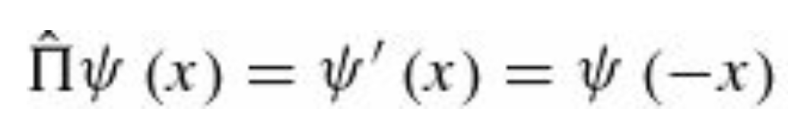
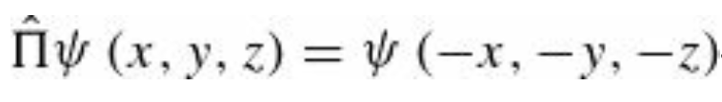
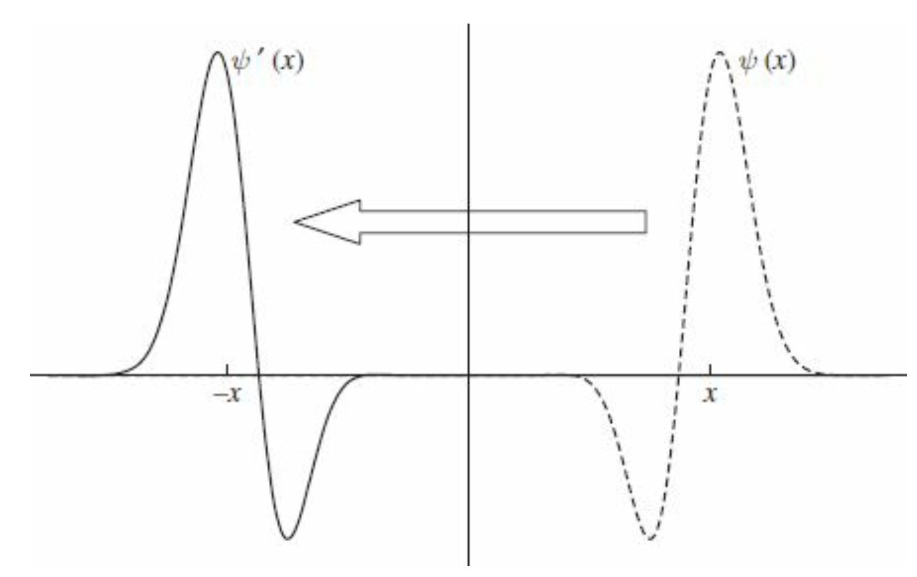
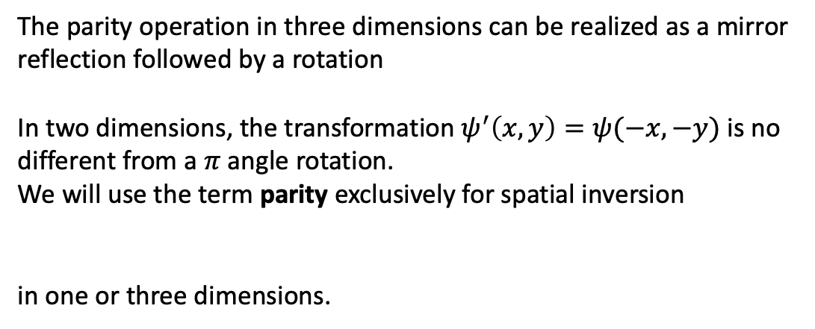
Transformations in space: Inversions
The operator that reflects a function about the origin, the parity operator in one dimension, is defined by
The effect of parity is shown graphically below. In 3-dim, parity changes the sign of all three coordinates
The parity operation in three dimensions can be realized as a mirror
reflection followed by a rotation
In two dimensions, the transformation $ψ^{′}\left(x,y\right)=ψ(−x,−y)$ is no
different from a $π$ angle rotation.
We will use the term parity exclusively for spatial inversion
in one or three dimensions.

Slide 12
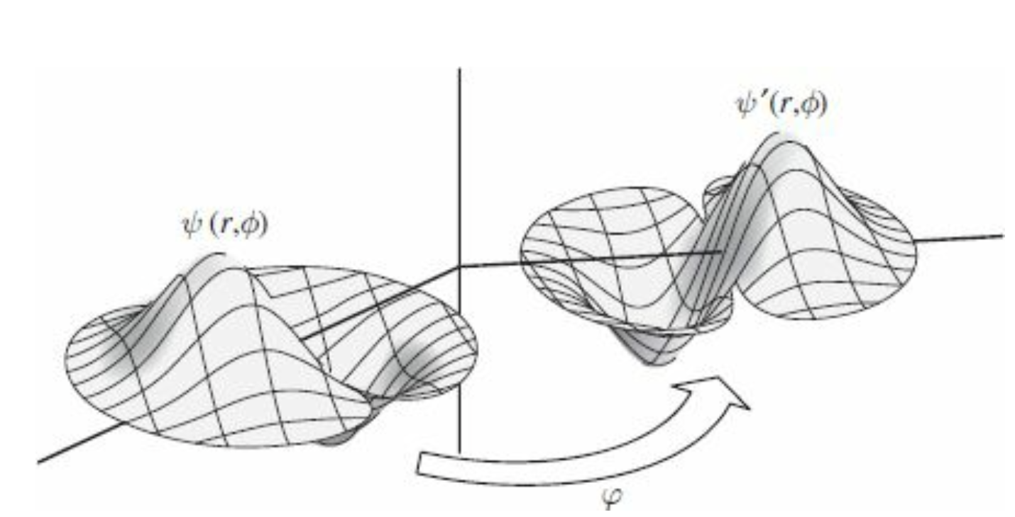
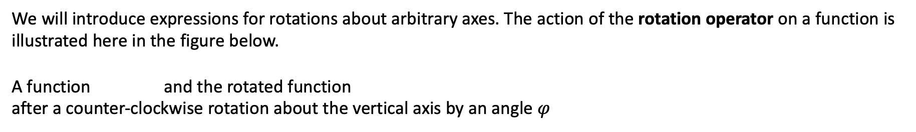
Transformations in space: Rotations
Finally, the operator that rotates a function about the $z$ axis through an angle $φ$ is most naturally expressed in polar coordinates as
We will introduce expressions for rotations about arbitrary axes. The action of the rotation operator on a function is
illustrated here in the figure below.
A function and the rotated function
after a counter-clockwise rotation about the vertical axis by an angle $φ$

Slide 13
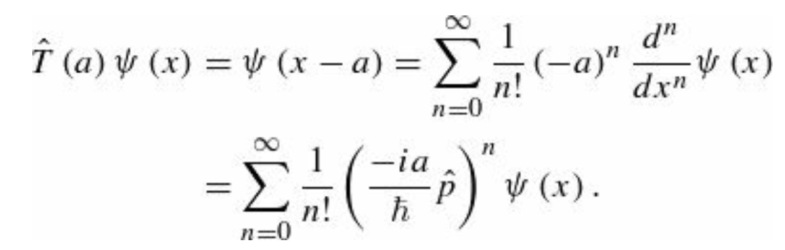
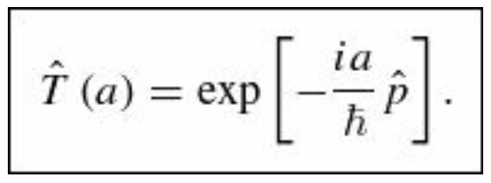
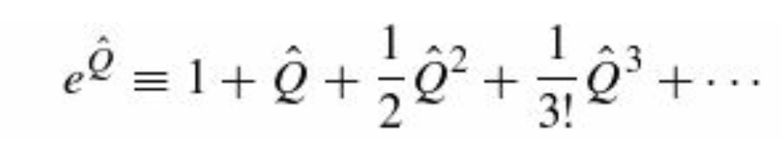
Translations: the translations operator
We can express the translation operator $\hat{T}(a)$ in terms of the momentum operator, to which it is intimately related.
To that end, we replace $ψ\left(x−a\right)$ by its Taylor Series. Therefore, we obtain ($ψ\left(x−a\right)=ψ(x_{0}+∆x)$; $x≡x_{0}$ and $∆x=−a$ )
The right-hand side of this equation is the
exponential function

